Slide 1



WELCOME
SOFTWARE
ENGINEERS

Slide 2
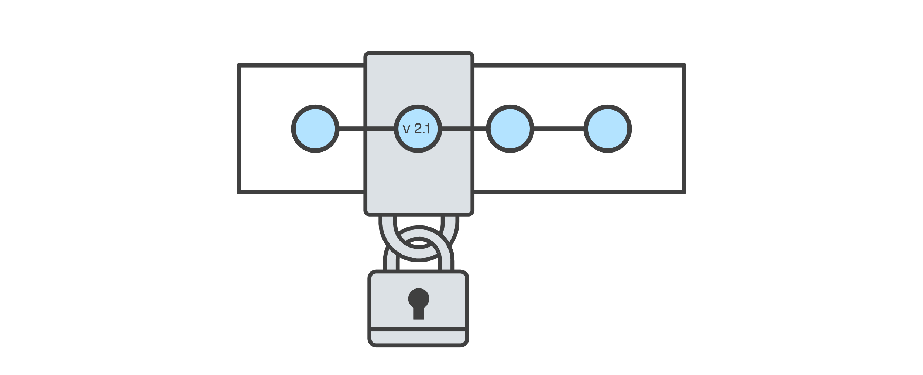
Version Control
VERSION
CONTROL
Records changes to a file or set of files over time so that you can recall specific versions later.
Notes:
compare files,
identify differences,
and merge the changes
when new developers join the team, they can easily download the current version of the application to their local environment using the version control system and are able to keep track of the version they’re currently running.
During development, you can also have entirely independent code versions if you prefer to keep different development efforts separate. When ready, you can merge the files to create a final working version.

Slide 3

Version Control
GIT
Version-control system.
For tracking changes in computer files.
Coordinating work on those files.
Among multiple people.

Slide 4

Version Control
GITHUB
Web-based hosting service for version control using Git.
Offers all of the distributed version control.
Offers source code management functionality of Git as well as adding its own features.

Slide 5
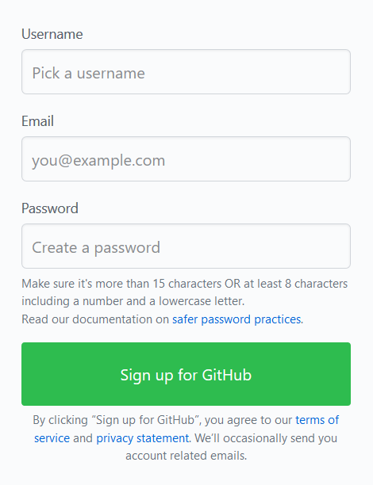
Creating a GitHub Account

Slide 6
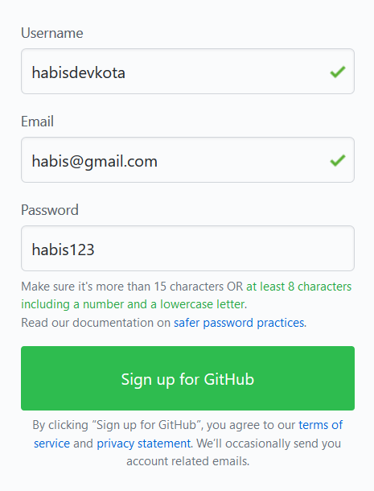
Creating a GitHub Account

Slide 7

Verify Email

Slide 8
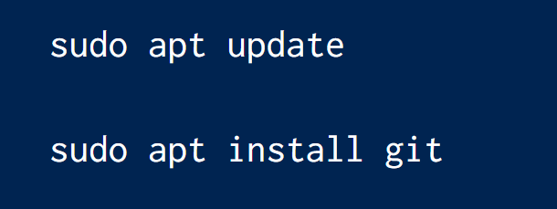

Git Installation for Linux
Linux is first choice of programmers.

Slide 9
Git Installation for MacOS
Rich kids, proceed.

Slide 10
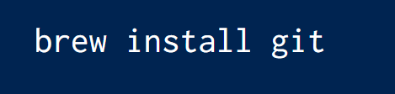
Git Installation for MacOS
Rich kids, proceed.

Slide 11
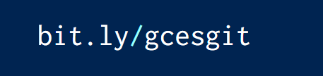
Git Installation for Windows

Slide 12
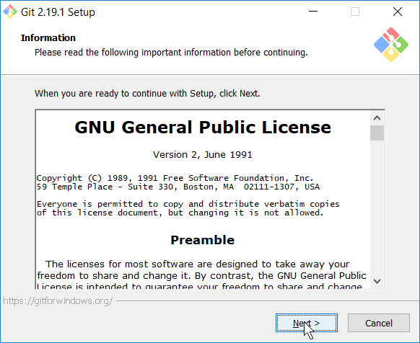
Git Installation for Windows

Slide 13
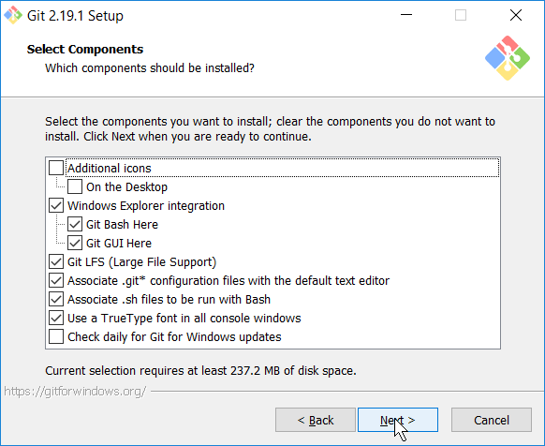
Git Installation for Windows

Slide 14
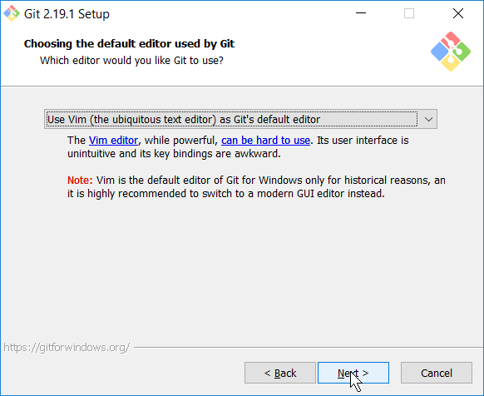
Git Installation for Windows

Slide 15
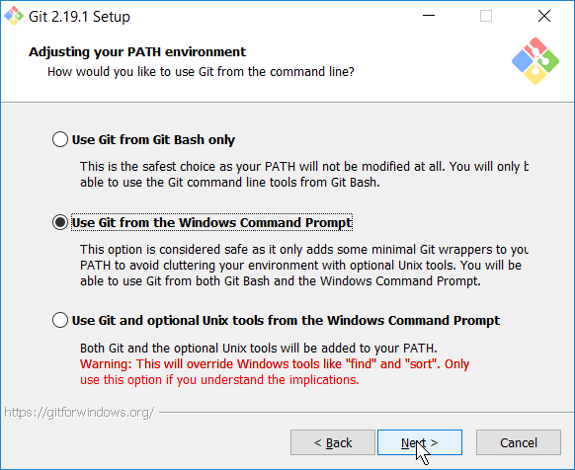
Git Installation for Windows

Slide 16
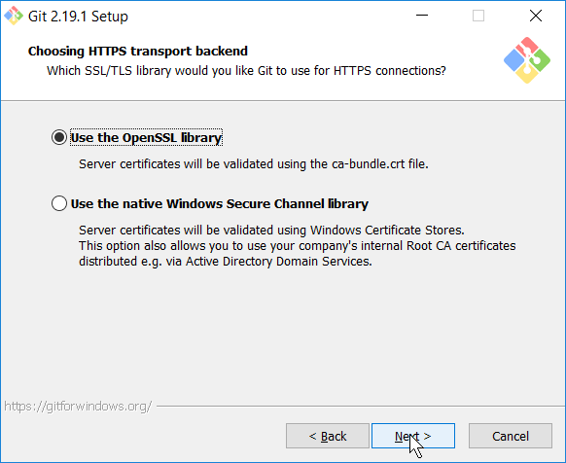
Git Installation for Windows

Slide 17
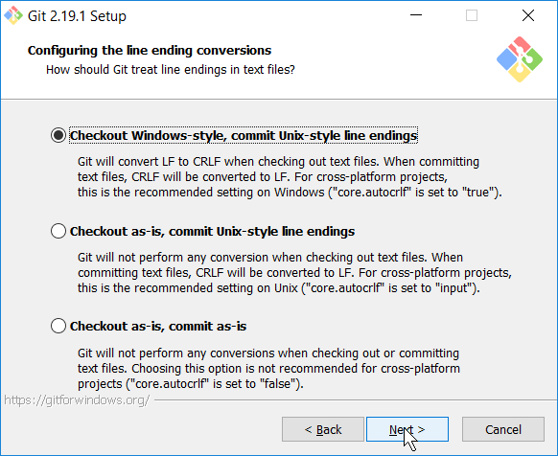
Git Installation for Windows

Slide 18
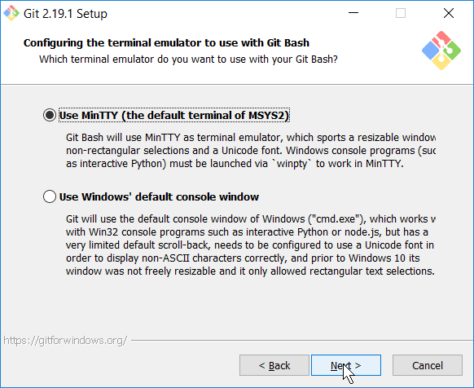
Git Installation for Windows

Slide 19
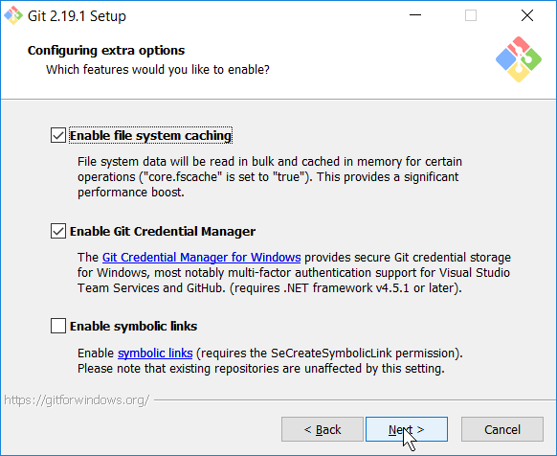
Git Installation for Windows

Slide 20
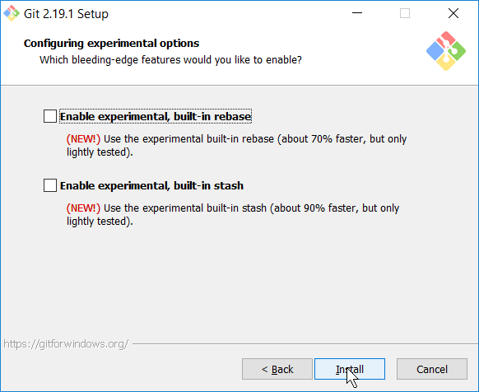
Git Installation for Windows

Slide 21
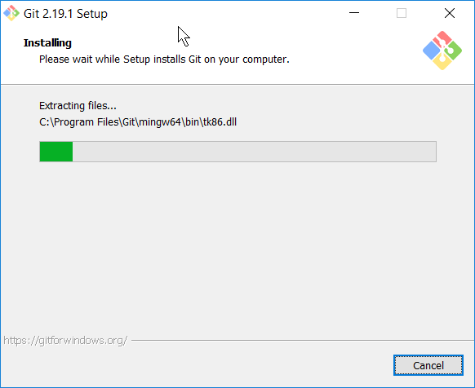
Git Installation for Windows

Slide 22
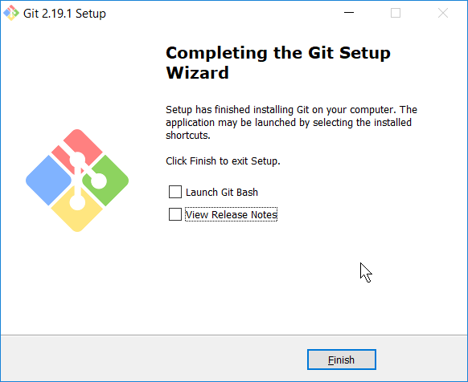
Git Installation for Windows

Slide 23
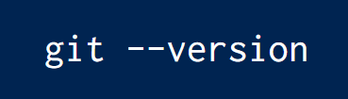
Checking Git Installation
Make sure you have newer version installed.

Slide 24
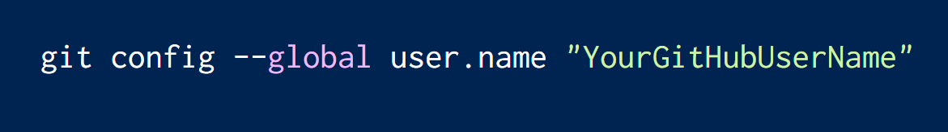
Git Configuration

Slide 25
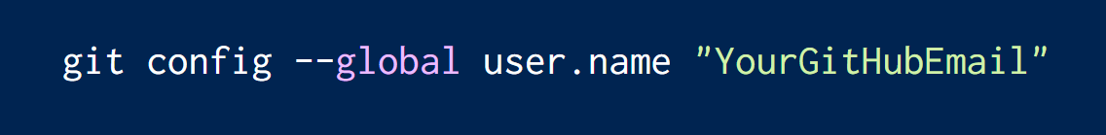
Git Configuration
Enter .edu email if you have.

Slide 26
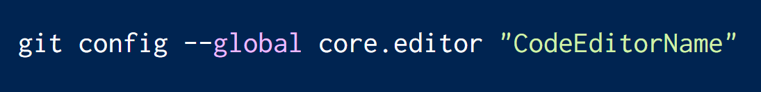
Git Configuration
Default is VIM editor; change to other.

Slide 27
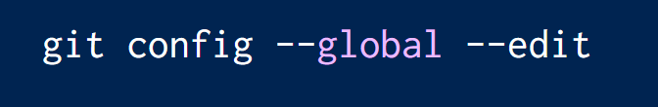
Git Configuration

Slide 28
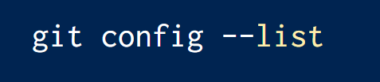
Checking Git Configuration
It displays list of configurations.

Slide 29
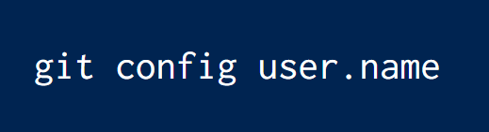
Checking Username
Make sure to check once !

Slide 30
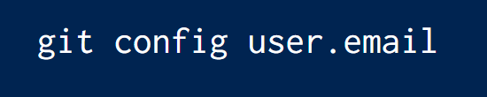
Checking Email
Make sure to check once !

Slide 31
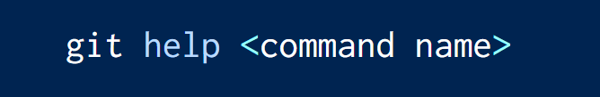
If you ever get stuck !
It loads offline documentation.

Slide 32
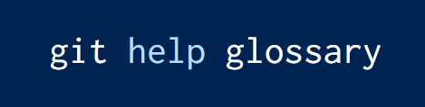
Let’s play with terms

Slide 33
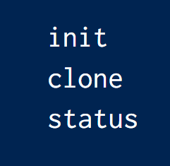
Let’s dive !

Slide 34
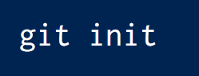
Git Initialization
Now, your folder is initialized as Git Repository.

Slide 35
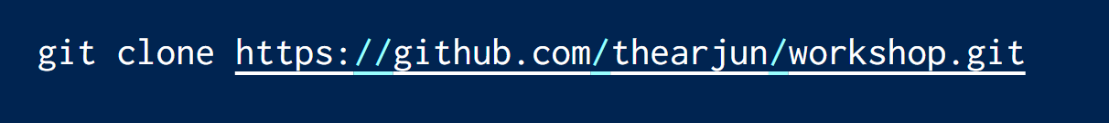
Git Cloning

Slide 36
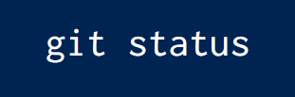
Checking Git Status
Not Facebook Status 😎
Notes:
--stat

Slide 37
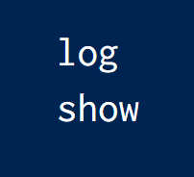
Review Repository

Slide 38
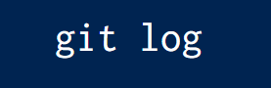
Reviewing Logs
It displays logs of commits.

Slide 39
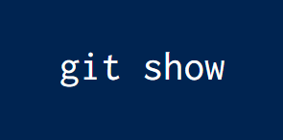
Complete Review
It shows a bunch of information such as commits, diffs, etc.
Notes:
it shows a bunch of information such as commits, diffs, etc.
Git show <commit code>

Slide 40
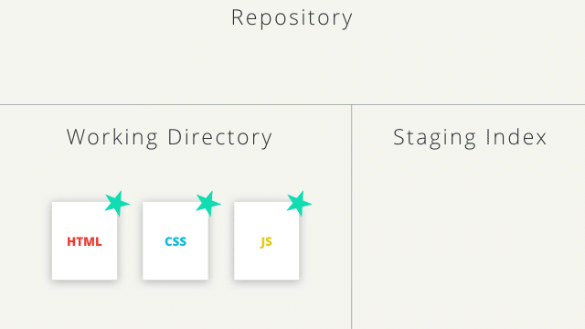
Git Repository Architecture
Working Directory ➡ Tracking / Staging Area ➡ Git Repository
Notes:
Asmit lai feri working to staging to git repository banaune vanne

Slide 41
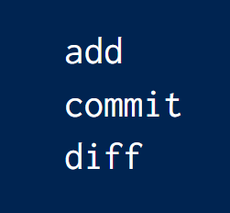
Working With Files

Slide 42
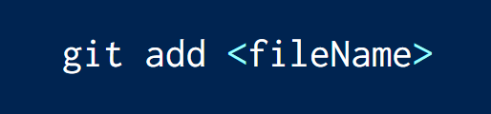
Adding Files to Repository
This will track / stage selected file.

Slide 43
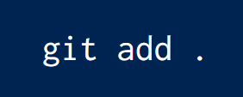
Adding Files to Repository
This will track / stage all files of current directory.

Slide 44
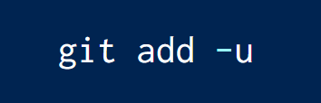
Adding Files to Repository
This will track / stage all files of working directory.

Slide 45
Committing Changes to Repository
It’s all about love. COMMITMENT matters.

Slide 46
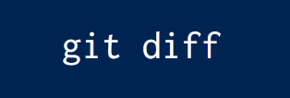
Checking Difference in Files
It checks difference in file between working directory and repository.

Slide 47
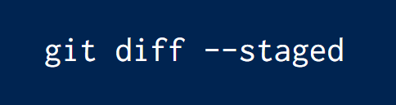
Checking Difference in Files
It checks difference in file between staging area and repository.

Slide 48
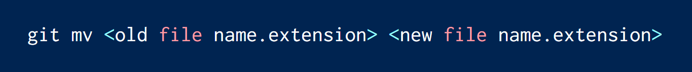
Renaming Files
Extension of file is mandatory.

Slide 49
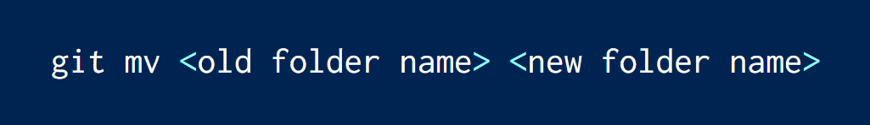
Renaming Folder

Slide 50
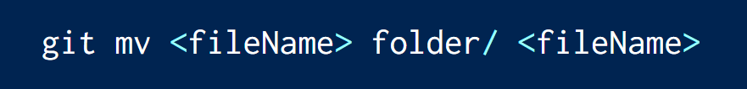
Moving Files
In Git, renaming and moving are done by mv.

Slide 51
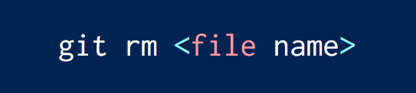
Removing Files
It needs commit too.

Slide 52

Tea Break
b'O rf]6L yk]/ s;}n] gvfg' lg

Slide 53
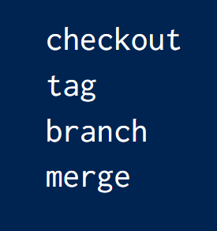
Let’s dive deeper !

Slide 54

Checkout
Act of switching between different versions.

Slide 55
Checkout
Works on following entities :
Files
Commits
Branches

Slide 56
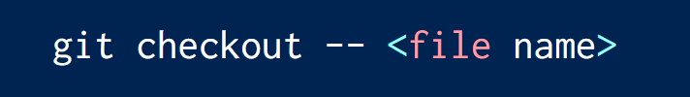
Checkout on file
Undoing the uncommitted changes

Slide 57
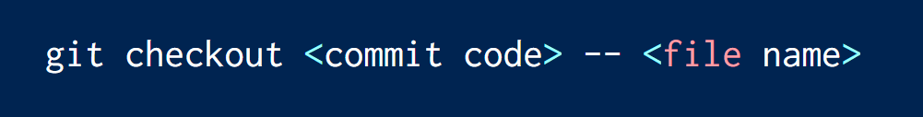
Checkout on commit
Getting the old versions from repository

Slide 58
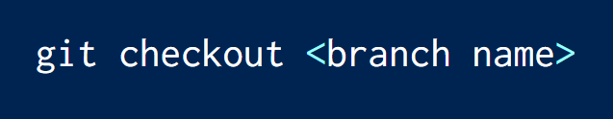
Checkout on Branch
Changing the active branch

Slide 59

Tag
It marks the milestones and create restore points.
Notes:
Yo chahi asmit le describe garne

Slide 60
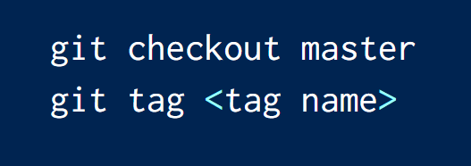
Creating tags
Checkout is necessary to create tag at master branch.

Slide 61

Creating tags with annotation
-a means annotation here.

Slide 62

Displaying Tags
Notes:
Using wild cards:
Git tag –l “v1.* ”

Slide 63

Deleting Tags
--delete can be replace by –d .
Notes:
Git push origin –delete v1.o // deleting from remote
Git push origin –delete v1.o v1.1

Slide 64

Branches
simply a lightweight movable pointer to one of these commits.
Notes:
Yo chahi asmit le describe garne

Slide 65

Creating Branches
Branch is usually created when a feature is being added.
Notes:
Ahile chahi hami master branch ma chau hai

Slide 66

Displaying Branches
Notes:
Branch dekhayo ki dekhayena heram ta

Slide 67

Switching Branches
Notes:
Git status rakhera check garam ta

Slide 68

Merging Branches
Master is default branch. Other branches get merged here.

Slide 69

Deleting Branches
Checkout to master is mandatory before deleting other branch.

Slide 70

We do a lot of mistakes
Even Michael Jordan missed his 9000 shots.
Mistakes are important !

Slide 71

Correcting the mistaken commit message
Change text editor to notepad; VIM is hard to learn.

Slide 72

Reverting the commit
Revert means to return into previous state.
Mistaken commit’s code is passed.
Notes:
Tyo last ma jun cha tehi pass garne ho ; first ko 7 ota character pass gare ni huncha

Slide 73

Reset the uncommitted changes
File need to be staged / tracked for this operation.
Notes:
Tyo last ma jun cha tehi pass garne ho ; first ko 7 ota character pass gare ni huncha

Slide 74

Reset the committed changes
This operation is potentially destructive.
Handle with care.
Notes:
Jun bela ko commit history pass gare ni huncha; first ko 7 ota character pass gare ni huncha

Slide 75

Ignoring Files and Folders
Create .gitignore file at the root of the Git Repository.

Slide 76

README.md
Markdown is a lightweight markup language with plain text formatting syntax.
Markdown is widely used in GitHub and Stack Overflow.

Slide 77

ASK ME ANYTHING

Slide 78

THANKS

